Slide 1
Introduction to the Legislative Process
January 2025
Notes:
Introductions / who we are
The RD is one of five divisions that comprise the Legislative Counsel Bureau, the nonpartisan staff agency that serves Nevada state legislators.
Our mission is to provide nonpartisan and high-quality policy analysis, research, and assistance to the Nevada Legislature—its members, committees, and constituents.

Slide 2
Overview
Legislative Structure
The Legislative Process
Reading a Bill
Tips for Advocating Your Issues​
​
Tips for Testifying Before Legislative Committees​
​
Resources for Tracking Legislation
Notes:
This morning we are going to provide an overview of the Legislature, legislative structure, and process;
Discuss part-time Legislature, Biennial Legislature;
83nd Legislature begins on February 3, 2025 (first Monday of February, running 120 days); and
Discuss opportunities and tips for working with both interim committees/their Chairs, and individual legislators.

Slide 3
Legislative structure
Senate
21 Members, 4-Year Terms
Assembly
42 Members, 2-Year Terms
Regular Legislative Sessions–Biennial
Regular sessions held in odd-numbered years
Sessions begin on the first Monday in February
Limited to 120-calendar days
The 83rd Legislative Session starts February 3, 2025

Slide 4
Legislative process
How a bill becomes a law
1. Initial Steps by the Sponsor
Idea, Bill Draft Request (BDR)
Note: Lobbyists are involved throughout process
2. Action in the House of Origin
Introduction, Refer to Committee
Public Hearing, Recommendation
Read Bill 3 Times
3. Action in the Second House
Same as House of Origin
4. Resolution of Differences
Conference Committee
5. Role of the Governor
Sign, Not Sign, Veto
Notes:
Initial Steps – The Veterans Legislative Symposium is a perfect example of where BDR ideas are generated.
House of origin – in the Senate, bills are referred to committees according to the Standing Rules of the Senate. In the Assembly, bills are referred by topic.
Read 3 times = Introduction; read a second time after committee takes action, read third time when house takes action

Slide 5
Legislative Process
Committee hearings
Same process in Senate and Assembly
Committee Chair schedules bills:
Agendas are posted
All meetings are public
Most meetings are videoconferenced from Carson City to Las Vegas and the public is encouraged to participate
Sponsor’s responsibilities include:
Presenting the bill (sometimes with the help of interested constituents or bill proponents)
Identifying and notifying speakers
Keeping the committee Chair informed
Following the bill
Notes:
Chair instructs staff as to what bills will be scheduled and when.

Slide 6
Testifying in Committee
Thank the Chair and committee for the opportunity to speak
State your name and organization
Clearly state your position and what you support or oppose in the bill
Refer to the bill by its number and be sure you are using the most recent version
Summarize your recommendations first, then add explanation
Conclude with a brief statement reiterating your position and offer to answer questions
Notes:
Formal process:
Address the Chair (“Mr.” or “Madam” Chair) and members of the committee (TO YOU AND THROUGH)
Be brief and specific
Consider providing a written copy of your testimony for the record (electronic preferred)
https://www.leg.state.nv.us/Division/Research/Documents/Testifying-Before-Legislative-Committee.pdf

Slide 7
Legislative Process
Committee hearings – common committee actions
Do Pass
Amend and Do Pass
Be Adopted
Rerefer (with or without recommendation)
Indefinitely Postpone (IP)
No Action
Notes:
Committees make several types of recommendations on legislative measures that come before them for consideration.

Slide 8
Legislative process
Settlement of house differences (if Necessary)
If the bill has no amendments in the second house, it goes to the Governor
If the bill is amended by second house:
Does the first house “Concur” (agree) with the amendment? If so, the bill goes to the Governor
If the first house “does not concur” with the amendment, does the second house “Recede” (withdraw) its amendment? If so, the bill goes to the Governor
If the second house “does not recede” its amendment, the bill is assigned to a conference committee
Once a consensus is reached in the conference committee, the bill goes to the Governor
Notes:
There is a process for working out differences between the houses. Find a compromise on a bill.
Conference committees include a 3 members from each house-2 of whom voted in favor of the bill. They can work out differences in a number of ways. If the bill is amended by the committee, it must be approved by each house.

Slide 9
Legislative process
Role of the governor
Sign the bill
Within 5 days if Legislature is in session (excluding the day of receipt and Sundays)
Within 10 days if Legislature has adjourned (excluding the day of receipt and Sundays)
Veto the bill
Not sign the bill within the period allowed (effectively allowing the bill to go into law without his signature)
Notes:
There are a few options when a bill reaches the Governor’s desk.

Slide 10
Reading a Bill
HEADING:
Contains information on who requested the bill, to which committee the bill was referred, a summary and BDR number, Fiscal Note status, and certain other information as needed
LEGISLATIVE Counsel’s DIGEST:
Summarizes how the bill changes current law (very helpful), but note the Digest is not part of the bill and does not become part of the law

Slide 11
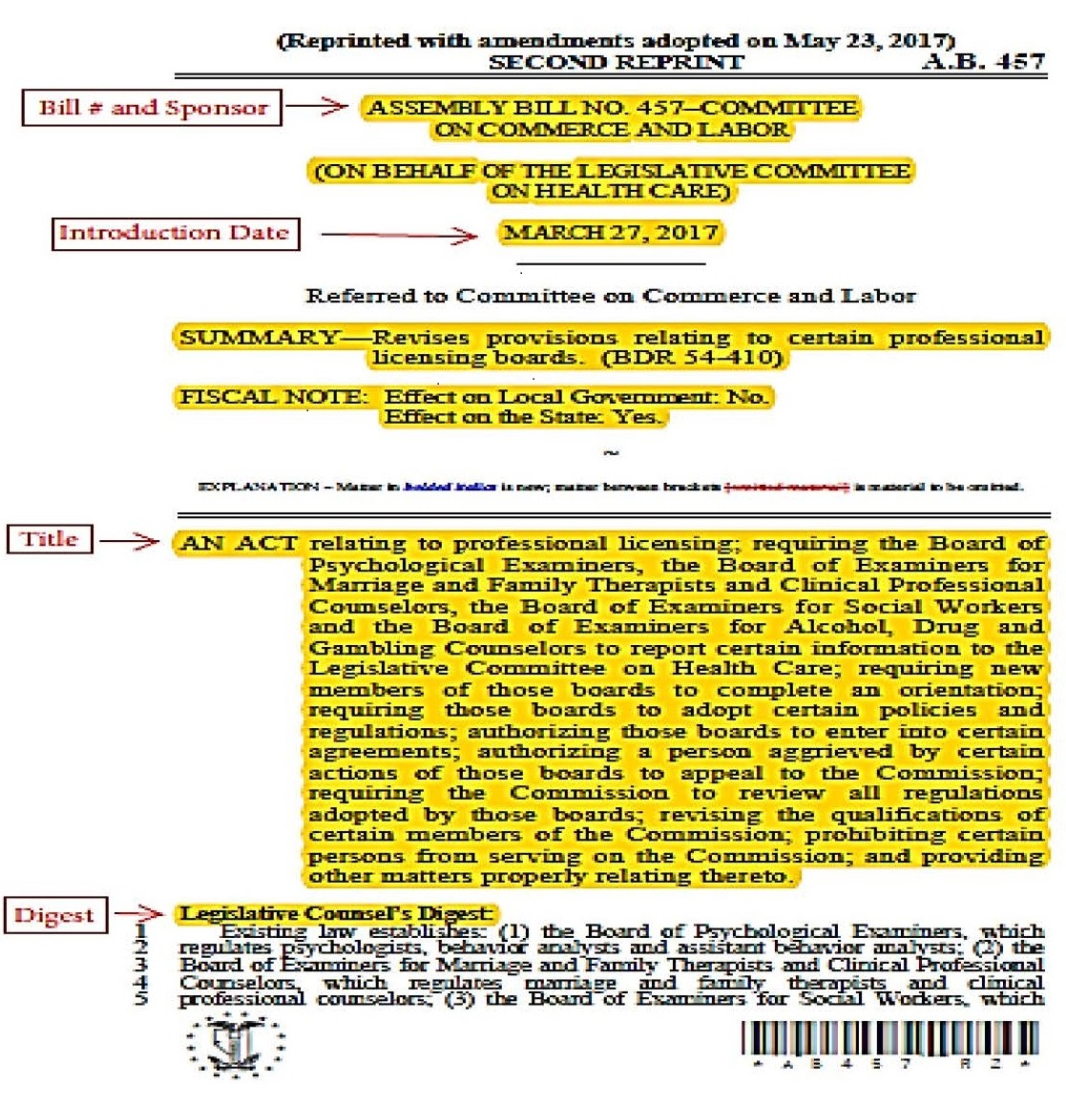
Bill components
Enacting Clause
Bill No. and Sponsor
Introduction Date
Sections
Notes:
Quick overview –
Heading:
Contains information on who requested the bill, which committee the bill was referred, a summary and BDR number, Fiscal Note status, and certain other information as needed.
Legislative Counsel’s Digest:
Summarizes how the bill changes current law (very helpful), but note that the Digest is not part of the bill and does not become part of the law.

Slide 12
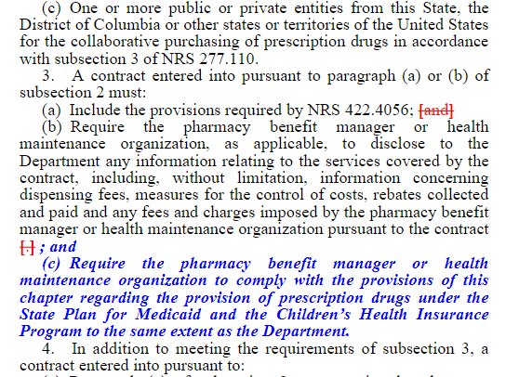
Reading a bill
Section headings (black)
Identify new Nevada Revised Statutes (NRS) provision being added or existing NRS provision being amended
Italicized and bolded language (blue)
New wording to be added to NRS
Bracketed and crossed out language (red)
Proposed for deletion from NRS
Notes:
Once a bill starts to get amended, different colors get added.

Slide 13
Effective dates
Bills without a specific effective date become law on October 1 after the session
Bills effective on “passage and approval” become law when signed or allowed to become law by the Governor
Bills may be made effective on July 1 of a certain year (to coincide with the start of a fiscal year) or January 1—or any other date on the bill
Notes:
Various effective dates. Important to consider when developing bill ideas, but even more important for implementation.

Slide 14
Advocating Your Issues
Do:
Choose a legislator(s) who you think will support your position
Get to know your legislator
Explain the positive aspects and benefits of your suggested legislation
Explain what the opposition might be
Prepare the legislator
Notes:
Prepare the legislator: Not always aware of the background information, don’t assume they know the issue, give them as much concise information as possible

Slide 15
Advocating Your Issues
Do:
Be calm, controlled, and prepared
Think your position through and weigh all sides of the issue
Know what you want to accomplish and how to accomplish it
Present your position in a non-threatening and professional manner

Slide 16
Advocating Your Issues
Do Not:
Make demands or threaten legislators
Disrupt the meeting
Use civil disobedience
Lecture or talk down to legislators
Be disrespectful toward members of the public or staff

Slide 17
Bill tracking
Nevada Electronic Legislative Information System (NELIS)
Information always available:
Bills – Reports – Bill Actions and Status
Personalized Legislative Tracking (PLT)
Subscription to BDRs, Bills, and Budgets (Up to 10 bills for free)
Notifications of Hearings and Status (not a free option)
Various Subscription Levels
Email: publications@lcb.state.nv.us
Phone: (775) 684-6835
Notes:
Helpful online resources to track BDRs, bills, budgets during session. Can also be notified of changes

Slide 18
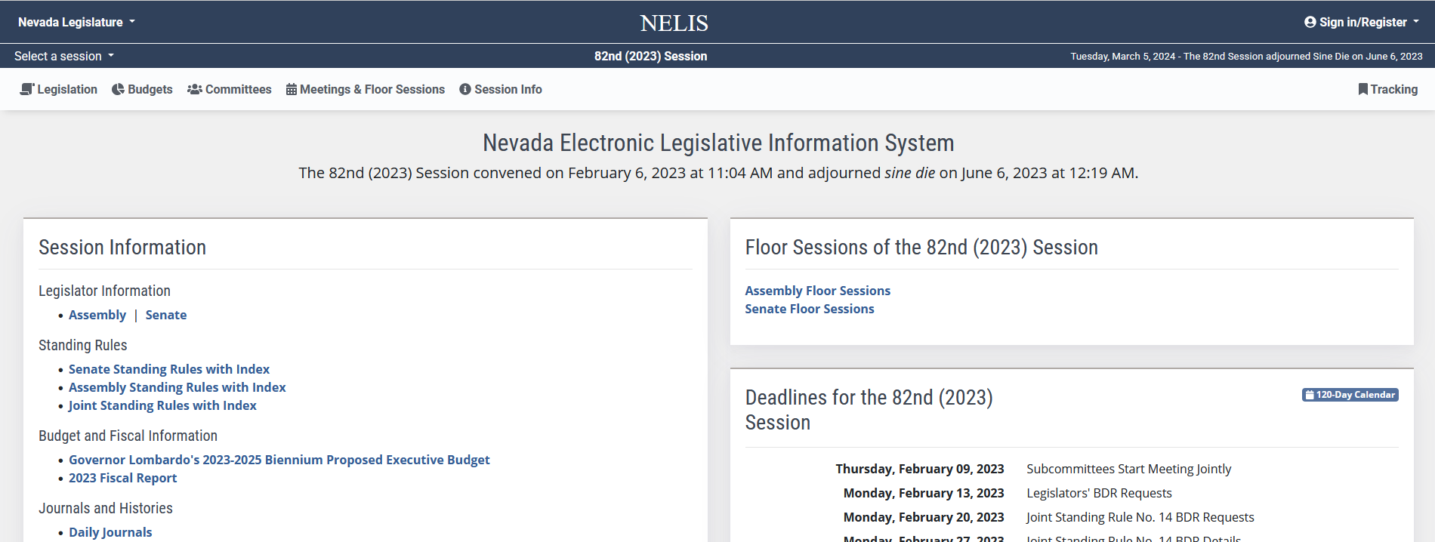
Bill Tracking
Sign In/Register
Click to Track
Click “Tracking” to view your list of tracked bills and updates
Notes:
Far Left: Nelis Website, in the top right corner there is a button that says “Sign in/Register”
Once you are signed in
Top Right, search the bill of choice and click the button with the bookmark that says “ click to track”

Slide 19
Ways to Stay Informed and Involved
Sign up for Bill Tracking
Search the BDR list (limited information until introduction)
Listen to or watch current or past hearings online
Check website for updates: www.leg.state.nv.us
Track legislative documents using NELIS
Get to know legislators and legislative staff

Slide 20
Ways to Stay Informed and Involved
Attend hearings or floor sessions
Sign up to speak during public comment at a hearing
Submit comments to the committee in writing
Talk to the legislators

Slide 21
contact
Research Division
(775) 684-6825
research@lcb.state.nv.us
Constituent Services Unit
(775) 684-6740
csu@lcb.state.nv.us
Research Library
(775) 684-6827
library@lcb.state.nv.us
Notes:
Provide our contact information. No wrong door. Feel free to contact us.
Reiterate that we work all interim and have CSU
Thank you for all you do, and allowing me to be here today.
I’ll be happy to answer any questions you may have.

